Slide 1
Updating the TRICS Good Practice Guide for 2019
Nick Rabbets
Managing Director - TRICS Consortium Limited
Notes:
This presentation is another targeted forum session, where I hope to get some ideas on the subject of the Good Practice Guide.

Slide 2
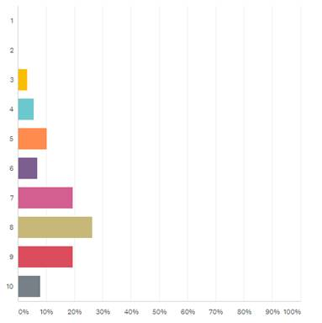
How useful do you find the TRICS Good Practice Guide in understanding the correct use and auditing of TRICS and its data (1=not useful, 10=extremely useful)?
Notes:
So to my last slide
I hope you are all aware of the Good Practice Guide that we produce to assist users in the use of the TRICS Database
These are the results from another question within the 2018 User Survey.
We are very pleased with the results, but would still like to improve in this area.

Slide 3
How useful do you find the TRICS Good Practice Guide in understanding the correct use and auditing of TRICS and its data (1=not useful, 10=extremely useful)?
What are the areas of improvement needed to the Good Practice Guide?
Using Older Versions of TRICS
Strictness of Search Criteria against the size of eventual Survey Samples
Consideration of Locational selection within Filtering
Avoiding “pre-determined” Trip Rates
Using Older TRICS Data
Dealing with Multi-Use and Linked Trips
Presenting Trip Generation Results and Selection Criteria Correctly
Commissioning TRICS-Compliant Surveys
Using the Travel Plan Monitoring Report Facility to show the impact of Travel Plans on surveyed sites
Any Other Specific Topics
Notes:
So really the purpose of this presentation is to find out from yourselves how we can improve the Guidance .
I have listed a few areas that might spark some discussion within the room. What areas of the guide that need improving or expansion?

Slide 4
Open Forum

